Slide 1
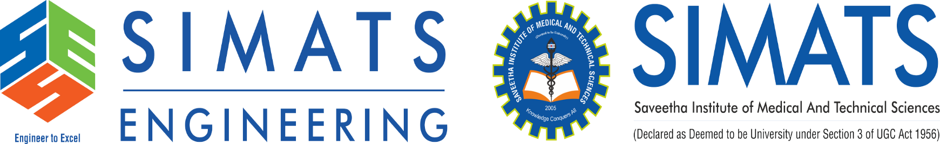
AI-Based Food Donation and Redistribution Platform Using NLP
Presented by : Galla Sai Siddartha (192425093)
: Ballani Venkata Manoj (192424350)
: Choda Anjaneya Venkata Naga Sai (192424283)
: Ankireddy Vikranth Reddy (192424193)
Subject code : DSA0304
Subject : Natural Language Processing
Guide name : Dr.T.Devi
Date : 26/08/2026

Slide 2


ABSTRACT
FoodRescue AI is an AI-based platform designed to reduce food wastage and improve the redistribution of surplus food to people in need.
The system uses Natural Language Processing (NLP) to extract important details such as food type, quantity, location, and availability from donor descriptions.
Semantic matching techniques are used to connect food donors with suitable NGOs, shelters, and receivers based on their requirements.
An NLP-based chatbot provides real-time assistance and guidance to donors, NGOs, and volunteers during the donation process.
Overall, the platform aims to create an efficient, intelligent, and user-friendly system that reduces food waste and ensures surplus food reaches the right beneficiaries at the right time.

Slide 3
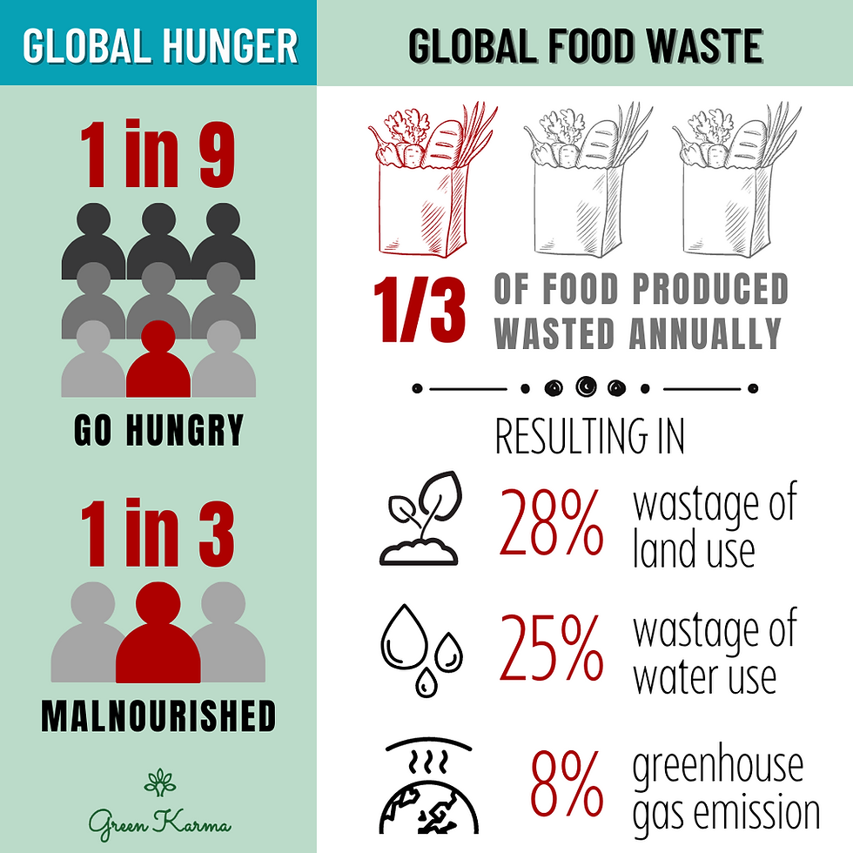
INTRODUCTION
Food wastage is a major problem despite increasing food insecurity.
Surplus food can be redistributed to NGOs instead of being wasted.
The proposed platform uses NLP to understand food donation details given in natural language.
FoodRescue AI uses AI to make smart food redistribution decisions.
The system extracts and classifies information such as food type, quantity, location, and expiry time.
Semantic matching helps connect suitable food donors with NGOs, shelters, and receivers.

Slide 4

PROBLEM STATEMENT
Large amounts of surplus edible food are wasted every day.
NGOs often struggle to receive the right quantity of food at the right time.
Manual NGO selection may lead to delays and inefficient food distribution.
Multiple factors such as distance, demand, and delivery success must be considered.
Traditional systems do not learn from previous donation and delivery outcomes.

Slide 5

OBJECTIVE
To develop an AI-based platform for efficient food donation and redistribution.
To use NLP for extracting food details from natural language descriptions.
To classify and analyze donated food based on its type and suitability.
To match food donors with suitable NGOs and receivers using semantic matching.
To provide an NLP-based chatbot for assisting users during the donation process.

Slide 6
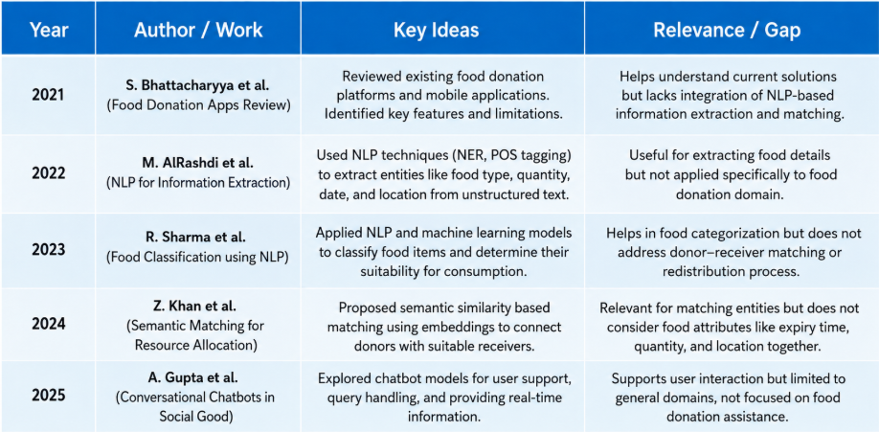
LITERATURE REVIEW

Slide 7
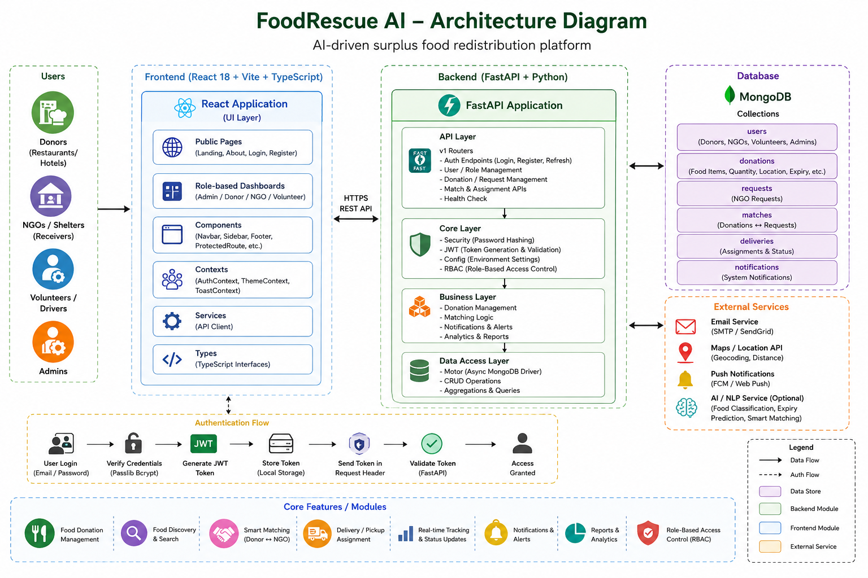
ARCHITECTURE DIAGRAM

Slide 8
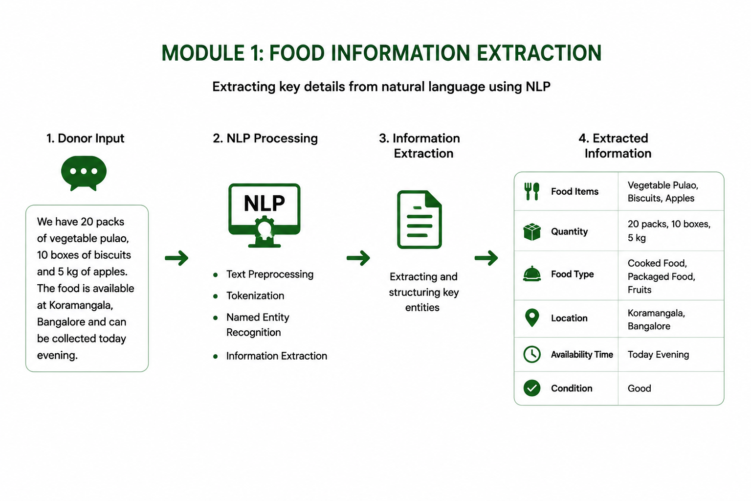
Module 1 : Natural Language Food Information Extraction
Purpose: Extract important food donation details from unstructured text provided by donors.
Input: Donors can enter descriptions such as “I have 20 boxes of cooked meals available in Hyderabad until 8 PM.”
NLP Processing: The system analyzes the text using NLP techniques such as tokenization, Named Entity Recognition (NER), and keyword extraction.
Information Extracted: Key details such as food type, quantity, location, expiry/availability time, and food condition are identified.

Slide 9
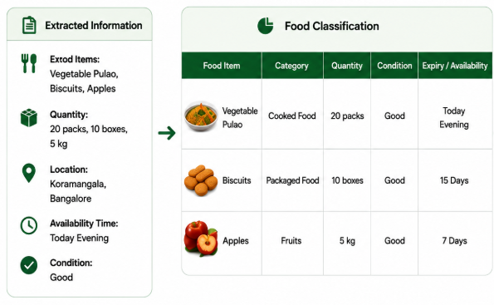
Module 2 : NLP-Based Food Classification and Analysis
Purpose: Classify the extracted food information into suitable food categories for efficient redistribution.
Input: Structured details from Module 1, including food name, quantity, condition, expiry time, and location.
NLP Techniques Used: Text preprocessing, tokenization, keyword extraction, NER, and text classification.
Classification Process: The system identifies whether the food belongs to categories such as cooked food, packaged food, fruits, vegetables, or other food items.
Output: The processed and classified food information is forwarded to the Semantic Donor

Slide 10
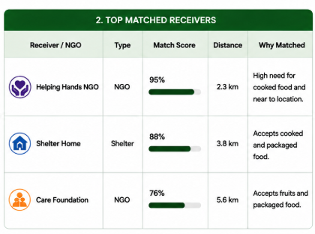
Module 3 : Semantic Donor and Receiver Matching
Purpose: Intelligently match available food donations with the most suitable NGOs, shelters, or receivers.
NLP Techniques Used: Text embeddings, semantic similarity, cosine similarity, keyword matching, and contextual analysis.
Matching Process: The system compares food descriptions with receiver requirements based on food type, quantity, location, availability time, and urgency.
Ranking: Suitable receivers are ranked according to their semantic similarity score and matching requirements.

Slide 11
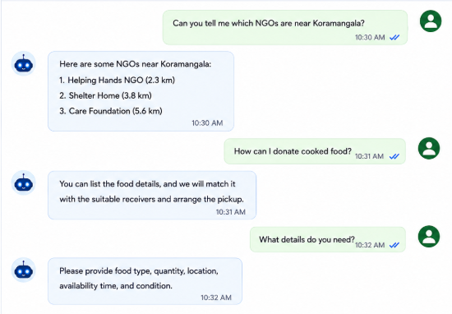
Module 4 : NLP-Based Food Assistance
Chatbot
Purpose: Provide intelligent assistance and guidance to donors, NGOs, and receivers.
NLP Techniques Used: Text preprocessing, tokenization, intent recognition, Named Entity Recognition (NER), keyword extraction.
Query Understanding: The chatbot identifies the user's intent and important entities from natural language queries.
Response Generation: Based on the identified intent, the system provides relevant information, guidance, and answers to user queries.

Slide 12
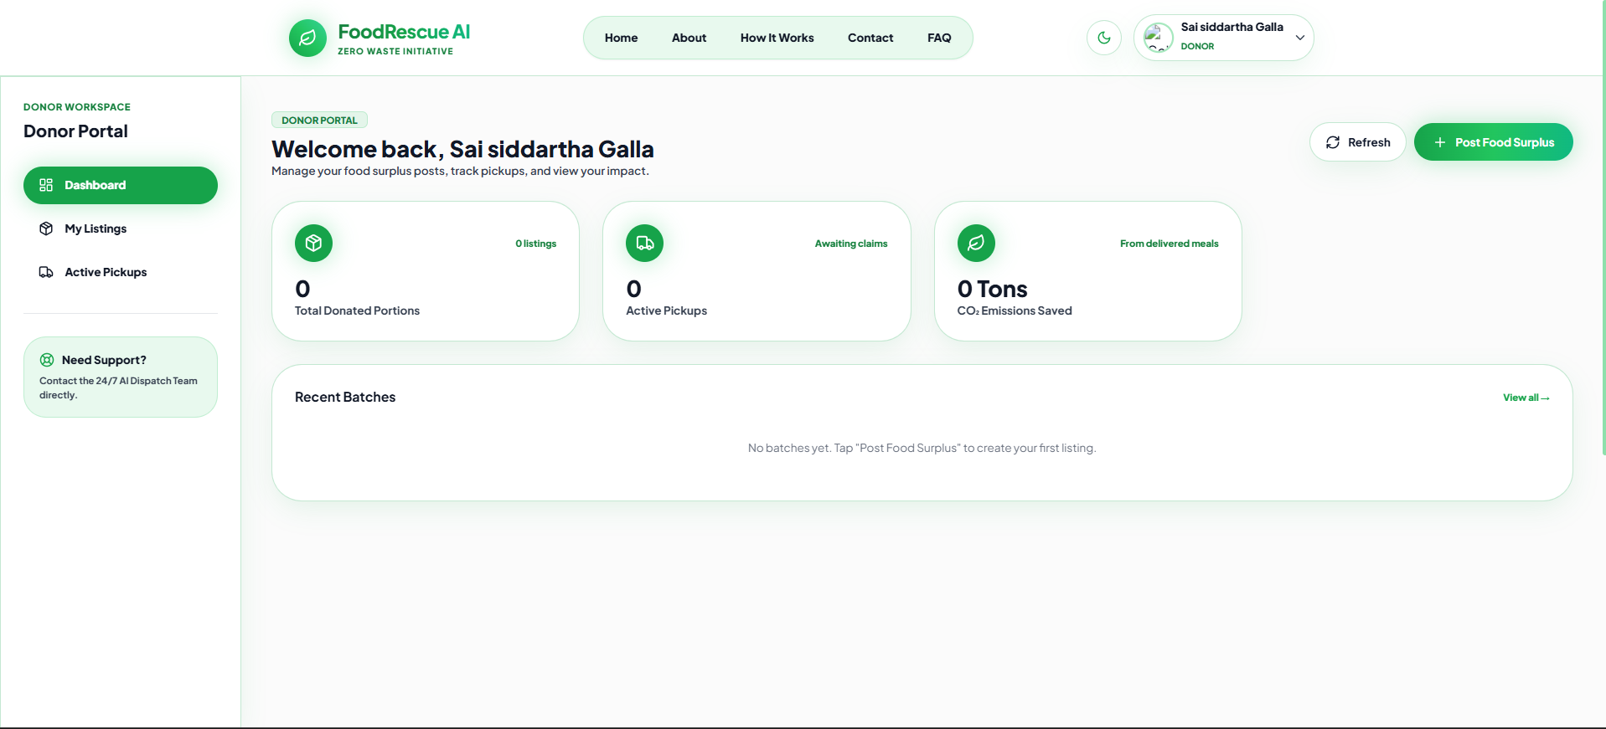
IMPLEMENTATION

Slide 13

TOOLS & TECHNOLOGIES
React.js & Node.js –
Frontend and backend development.
Supabase –
Database, authentication, and real-time data management.
Google Authentication & Twilio OTP –
Secure user authentication and verification.
NLP Techniques –
Used for information extraction, classification,chatbot processing.
JWT & RBAC –
Used for secure authentication and role-based access control
GitHub, VS Code & Postman –
Development, version control, and API testing.

Slide 14
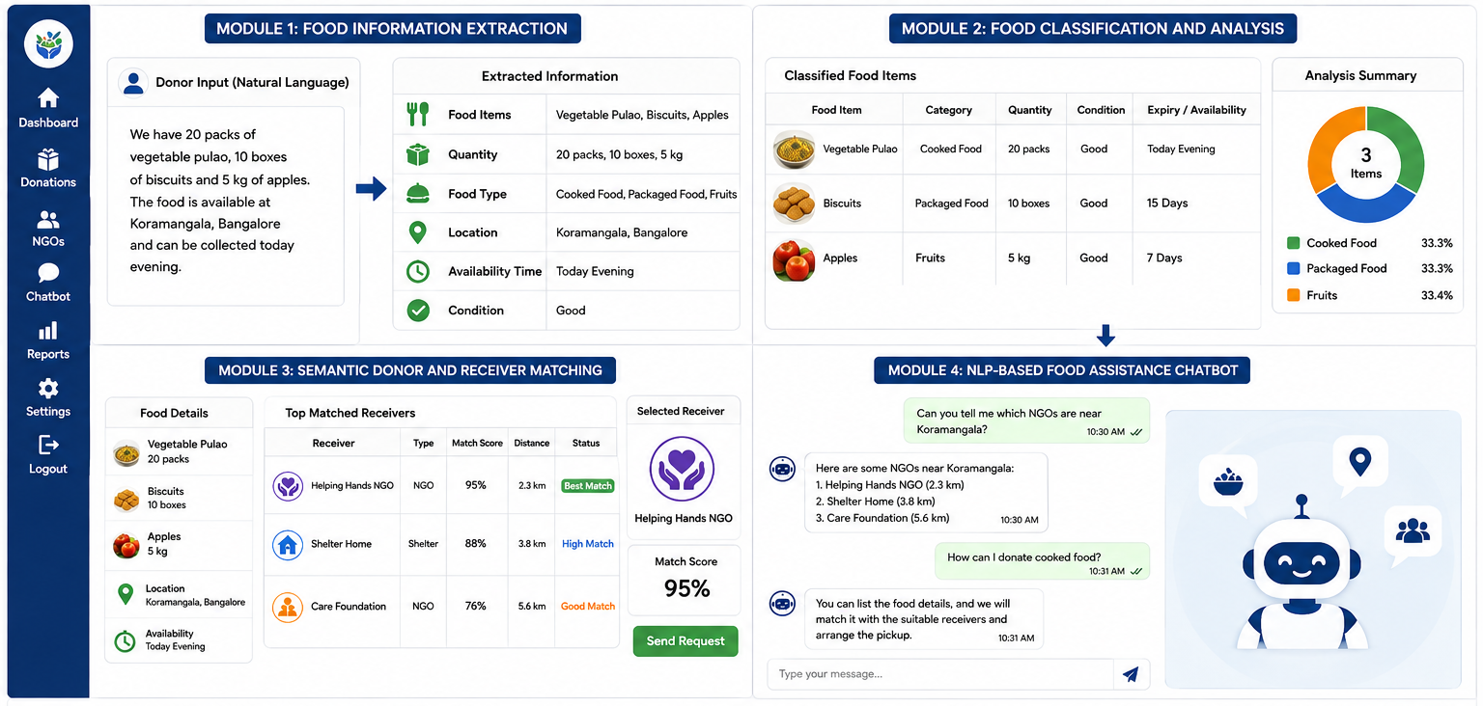
RESULTS

Slide 15
FUTURE ENHANCEMENTS
Real-Time Location Tracking – Integrate GPS to track food pickup and delivery in real time.
Advanced AI Prediction – Use machine learning to predict food demand and surplus availability.
Food Quality Detection – Integrate image analysis to identify food quality and freshness.
Smart Notification System – Send real-time alerts to suitable NGOs, volunteers, and receivers.
Multilingual Chatbot – Support multiple languages to make the platform accessible to more users.
Enhanced Matching System – Improve donor–receiver matching using advanced AI and recommendation techniques.

Slide 16
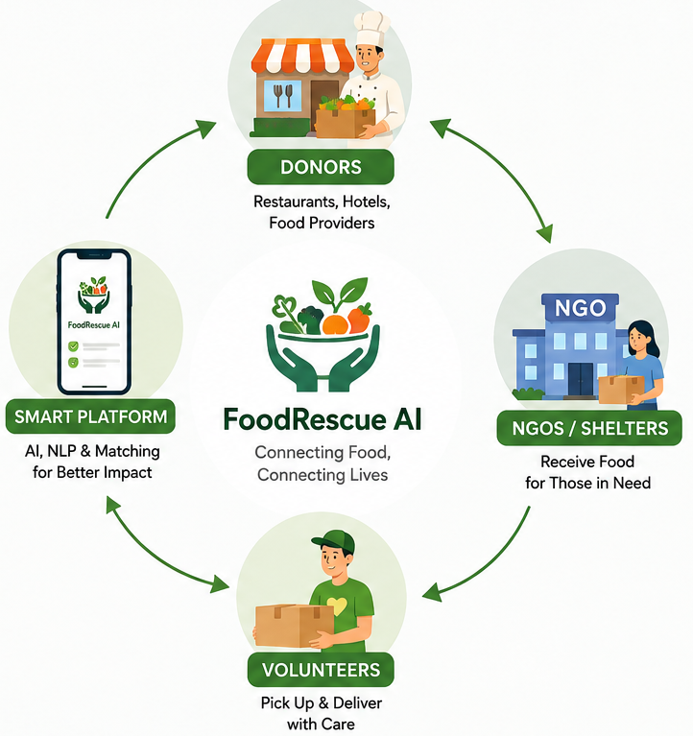
CONCLUSION
The proposed platform provides an intelligent solution for reducing food wastage through efficient food donation and redistribution.
NLP techniques help extract, classify, and analyze food information from natural language descriptions.
Semantic matching connects suitable donors with NGOs and receivers based on their requirements.
The NLP-based chatbot improves user interaction by providing quick assistance and guidance.
Overall, the system aims to ensure that surplus food reaches the right beneficiaries efficiently and on time.

Slide 17
REFERENCES
Jacob Devlin, Ming-Wei Chang, Kenton Lee, and Kristina Toutanova, “BERT: Pre-training of Deep Bidirectional Transformers for Language Understanding,” Proceedings of NAACL-HLT, pp. 4171–4186, 2019.
Nils Reimers and Iryna Gurevych, “Sentence-BERT: Sentence Embeddings using Siamese BERT-Networks,” Proceedings of EMNLP-IJCNLP, pp. 3982–3992, 2019.
Qiwei Peng, David Weir, and Julie Weeds, “Structure-aware Sentence Encoder in Bert-Based Siamese Network,” Proceedings of the 6th Workshop on Representation Learning for NLP, pp. 57–63, 2021.
MongoDB Inc., “MongoDB Documentation,” official documentation for database design, collections, and data management.

Slide 18


